Slide 1
Telework Tech Accessibility Trials & Triumphs
Alexa Huth, Strategic Communications Lead
Partnership on Employment & Accessible Technology (PEAT)

Slide 2
What We Will Cover
My Story of Vision Loss & Telework
The Rapid Digitization of Work & Rise of Telework
Procuring Accessible Technology
Turning Telework Trials into Triumphs
The Future of Accessible Telework
Questions and Answers

Slide 3
My Story of Vision Loss & Telework

Slide 4
The Rapid Digitization of Work & Rise of Telework

Slide 5
Employment and Technology​
Over 1 billion people worldwide have a ​disability.¹ ​
Making emerging technologies accessible could bring 350M people with disabilities into the global workforce.^{2​}
Companies who hire people with disabilities earn 28% higher revenue, 2X the net income and 30% higher economic profit margins than their peers.³
Sources: ​
1. US Dept of Labor, Office of Disability Employment Policy, Disability Employment Statistics​
2. Accenture, “Amplify accessibility: An accessible digital future”​
3. Accenture, “Getting to Equal: The Disability Inclusion Advantage”​
​

Slide 6
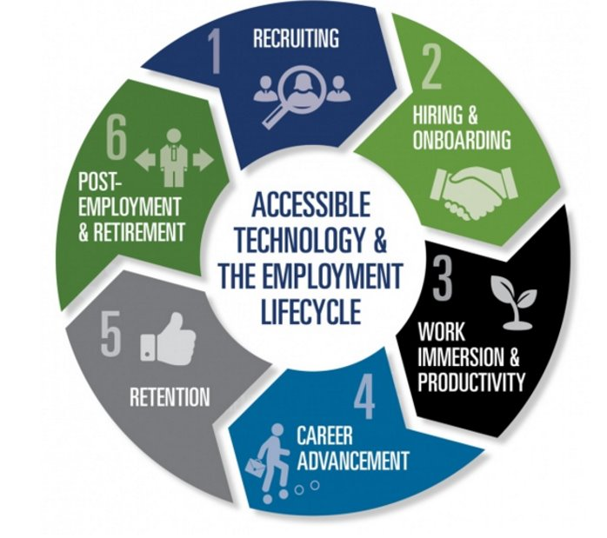
Technology at Every Stage of Employment

Slide 7
The Rapid Digitization of Work
Digitization accelerated rapidly. What occurred in 8 months would have otherwise taken 3-7 years (McKinsey)
The Equal Employment Opportunity Commission published legal guidance around telework, COVID & accommodations (EEOC)
Telework has normalized. Businesses know they must reinvent their practices to make telework presences equal to in-person experiences

Slide 8
The Challenges are Magnified
People with disabilities face magnified challenges when technology — and organizational culture — isn't accessible and inclusive
Platform limitations/interoperability
Inconsistent quality and user experience
Accessibility can vary by license level
Conflicting accommodation needs
Remote meetings are less accessible for some
Inexperience with new tools, paired with limitations on tech support for people using assistive technology remotely
Bandwidth & broadband access

Slide 9
2021: The Work Ahead
The Challenge:
Companies are quickly building a new wave of virtual infrastructure, but they may not be prioritizing accessibility
The Opportunity:
We’re at a unique moment in time to push the needle forward
Disability experiences can foster new and transformative ways to think about how we work

Slide 10
Procuring Accessible Telework Technology

Slide 11
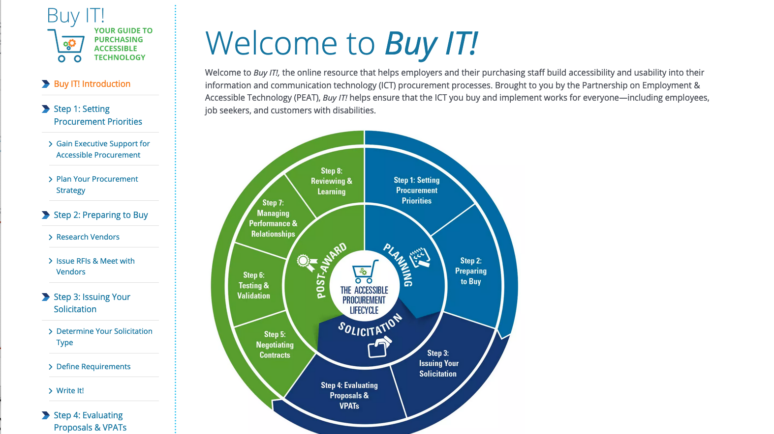

Slide 12
Step 1: Plan Your Procurement Strategy
Procuring Accessible Telework Technology

Slide 13
Gain Executive Support
Making the Business Case
Accessible technology fuels productivity.
It’s less expensive to buy the right product the first time.
Implementing accessible ICT mitigates legal risk.
Accessibility leads to improved and expanded recruitment.
Accessibility boosts employee retention.
Accessible tech fosters workplace diversity.

Slide 14
Define Your Target Users
Consider the needs of the widest array of users.
Visual
Cognitive
Physical
Communication
Emotional
Socio-Economic
Intersectional

Slide 15
Determine Your Technical Standards for Accessibility
A key part of planning your procurement strategy is understanding the standards and regulations your organization’s products should aim to meet.
Begin by exploring the following standards:
The U.S. federal government’s Section 508 of the Rehabilitation Act (Section 508)
The international Web Content Accessibility Guidelines (WCAG)
The European Standard “EN 301 549”

Slide 16
Define Your Purchasing Needs
Any procurement planning should include a comprehensive review of your company’s business requirements and overall purchasing needs.
Enables your company to purchase technology strategically.
Simplifies the process of creating an accessible workplace.

Slide 17
Assemble and Educate Your Purchasing Team
The team should include individuals from across the organization who have an interest in the needed product/service. This team will:
Define the project scope and requirements
Develop the solicitation
Evaluate the responses

Slide 18
Develop Procurement Policies for Accessibility
Identify and understand your company’s acquisition policies and procedures used to acquire technology.
Determine if adequate consideration of technical standards is already included in these policies and procedures. If they are not, work with the appropriate stakeholders to change this.
Develop criteria for when and how accessibility and technical requirements, exceptions, terms and conditions, evaluation methods, acceptance criteria, and related proposal response requirements are included in solicitations.

Slide 19
Develop Procurement Policies for Accessibility (continued)
Establish a formal accessibility compliance determination process.
Provide for independent expert reviews of accessibility exception and vendor accessibility claims prior to award.
Use a risk-based model to determine when independent testing is required to validate vendor conformance claims.
Provide authority to the Accessibility Program Team to stop any contract or application that puts the company at significant risk.
Create a governance process to ensure accessibility conformance is an evaluation factor in award decisions.

Slide 20
Moving Forward with Procurement
Step 2: Preparing to Buy
Step 3: Issuing Your Solicitation
Step 4: Evaluating Proposals & VPATs
Step 5: Negotiating Contracts
Step 6: Testing & Validation
Step 7: Managing Performance & Relationships
Step 8: Reviewing & Learning

Slide 21
Telework Trials and Triumphs
Accessible Technology in Practice

Slide 22
Turn Trials into Triumphs
“Can you see this?”
“As this chart shows, it’s been a great year.”
“Speak up now if you have questions.”
“Cameras on, I want to see your faces!”
“Can you hear me?”

Slide 23
The Future of Telework

Slide 24
Questions?

Slide 25
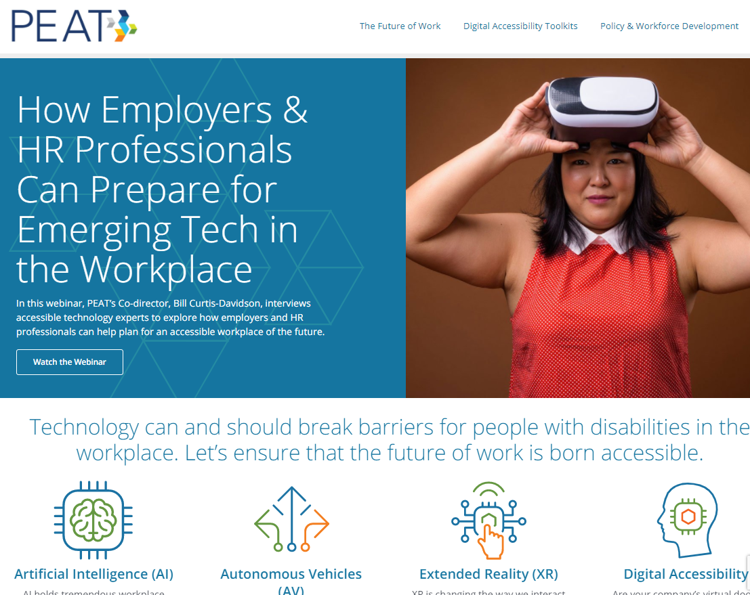
Join the Conversation
www.PeatWorks.org
@PeatWorks
PeatWorks.org/eNews
hello@PeatWorks.org
www.linkedin.com/in/alexahuth/
Alexa Huth Strategic Communications Lead Partnership on Employment & Accessible Technology

